Slide 1
JAVASCRIPT AND THE DOM
Continuing Education, University of Calgary
Adnan Ahmed (aeahmed@ucalgary.ca)

Slide 2

Outline
JavaScript basic syntax
  Date types
  Operators
  Statements

Slide 3
JavaScript Syntax
Case sensitivity
White space and line breaks
Statements
Variables, Literals
Datatypes and Operators
Conditional Statement
Functions
Objects

Slide 4
JavaScript : Operators
Arithmetic Operators
Equality Operators
Relational Operators
String Operators
Logical Operators
Assignment Operators
Conditional Operator

Slide 5
Arithmetic Operators
Addition (+)
The + operator adds numeric operands or concatenates string operands.
If one operand is a string, the other is converted to a string, and the two strings are then concatenated.
Object operands are converted to numbers or strings that can be added or concatenated.
When working with objects the conversion is performed by the valueOf( ) method and/or the toString( ) method of the object.

Slide 6
Arithmetic Operators
Subtraction (-)
When - is used as a binary operator, it subtracts it’s second operand from its first operand.
If used with nonnumeric operands, it attempts to convert them to numbers.

Slide 7
Arithmetic Operators
Multiplication (*)
The * operator multiplies its two operands. If used with nonnumeric operands, it attempts to convert them to numbers.

Slide 8
Arithmetic Operators
Division (/)
The / operator divides its first operand by its second.
If used with nonnumeric operands, it attempts to convert them to numbers.
In JavaScript all numbers are floating-point, so all division operations have floating-point results: 5/2 evaluates to 2.5, not 2.
Division by zero yields positive or negative infinity
while 0/0 evaluates to NaN.

Slide 9
Arithmetic Operators
Modulo (%)
The % operator returns the remainder when the first operand is divided by the second operand
If used with nonnumeric operands, the modulo operator attempts to convert them to numbers.
The sign of the result is the same as the sign of the first operand. For example, 5 % 2 evaluates to 1.
While the modulo operator is typically used with integer operands, it also works for floating-point values. For example, -4.3 % 2.1 evaluates to -0.1.

Slide 10
Arithmetic Operators
Unary minus (-)
When - is used as a unary operator, before a single operand, it performs unary negation.
In other words, it converts a positive value to an equivalently negative value, and vice versa.
If the operand is not a number, this operator attempts to convert it to one.

Slide 11
Arithmetic Operators
Unary plus (+)
For symmetry with the unary minus operator, JavaScript also has a unary plus operator. This operator allows you to explicitly specify the sign of numeric literals, if you feel that this will make your code clearer:
var profit = +1000000;
In code like this, the + operator does nothing; it simply evaluates to the value of it’s argument.
for nonnumeric arguments, the + operator has the effect of converting the argument to a number.
returns NaN if the argument cannot be converted.

Slide 12
Arithmetic Operators
Increment (++)
The ++ operator increments (i.e., adds 1) it’s single operand, which must be
  a variable
  an element of an array
  or a property of an object.

Slide 13
Arithmetic Operators
If the value of this variable, element, or property is not a number
  the operator first attempts to convert it to a number.
  The precise behavior of this operator depends on its position relative to the operand.
  When used before the operand, where it is known as the pre-increment operator, it increments the operand and evaluates to the incremented value of that operand.
  When used after the operand, where it is known as the post-increment operator, it increments its operand but evaluates to the unincremented value of that operand.
  If the value to be incremented is not a number, it is converted to one by this process.

Slide 14
Arithmetic Operators
For example, the following code sets both i and j to 2:
i = 1; j = ++i;
But these lines set i to 2 and j to 1:
i = 1; j = i++;

Slide 15
Arithmetic Operators
Decrement (--)
The -- operator decrements (i.e., subtracts 1 from) its single numeric operand, which must be a variable, an element of an array, or a property of an object.
Conversion works the same way as the ++ operator

Slide 16
Arithmetic Operators
Exercise:
  Declare two number num1 and num2 and assign values to them
  Add num1 and num 2, show results
    What will be the result of
      document.write("Num1 + Num2 is " + num1 + num2);
  Subtract num1 from num2
  Multiply num1 by num2
  Divide num1 by num2

Slide 17
Arithmetic Operators
Exercise:
  Find the remainder when num1 is divided by num2 (%)
  Divide num1 by 0
  Convert “1923” to number (parseInt())
  Increment num1 and set it to num2 without adding 1 to num1

Slide 18
Equality Operators
Equality (==) and Identity (===)
The == and === operators check whether two values are the same
Both operators accept operands of any type, and both return true if their operands are the same and false if they are different.

Slide 19
Equality Operators
The === operator is known as the identity operator, and it checks whether it’s two operands are "identical" using a strict definition of sameness.
The == operator is known as the equality operator; it checks whether it’s two operands are "equal" using a more relaxed definition of sameness that allows type conversions.

Slide 20
Equality Operators
To make things simple:
  read "gets or is assigned" for =
  "is equal to" for ==
  and "is identical to" for ===.

Slide 21
Equality Operators
numbers, strings, and boolean values are compared by value.
In this case, two separate values are involved
The == and === operators check that the two variables are equal or identical only if they contain the same value.
For example, two strings are equal only if they each contain exactly the same characters.

Slide 22
Equality Operators
objects, arrays, and functions are compared by reference. This means that two variables are equal only if they refer to the same object.
Two separate arrays are never equal or identical, even if they contain equal or identical elements.
Two variables that contain references to objects, arrays, or functions are equal only if they refer to the same object, array, or function.

Slide 23
Equality Operators
The following rules determine whether two values are identical according to the === operator:
  If the two values have different types, they are not identical.
  If both values are numbers and have the same value, they are identical, unless either or both values are NaN, in which case they are not identical.

Slide 24
Equality Operators
  If both values are strings and contain exactly the same characters in the same positions, they are identical.
  If the strings differ in length or content, they are not identical.
  If both values are the boolean value true or both are the boolean value false, they are identical.
  If both values refer to the same object, array, or function, they are identical. If they refer to different objects (or arrays or functions) they are not identical, even if both objects have identical properties or both arrays have identical elements.
  If both values are null or both values are undefined, they are identical.

Slide 25
Equality Operators
The following rules determine whether two values are equal according to the == operator:
If the two values have the same type, test them for identity.
If the values are identical, they are equal; if they are not identical, they are not equal.

Slide 26
Equality Operators
If the two values do not have the same type, they may still be equal. Use the following rules and type conversions to check for equality:
  If one value is null and the other is undefined, they are equal.
  If one value is a number and the other is a string, convert the string to a number and try the comparison again, using the converted value.

Slide 27
Equality Operators
  If one value is an object and the other is a number or string, convert the object to a primitive and try the comparison again.

Slide 28
Equality Operators
Inequality (!=) and Nonidentity (!==)
The != and !== operators test for the exact opposite of the == and === operators. The != inequality operator returns false if two values are equal to each other and returns true otherwise.
The !== nonidentity operator returns false if two values are identical to each other and returns true otherwise.

Slide 29
Equality Operators
Exercise : Try these with a console.log;
null == undefined and null === undefined
5 == "5“ and 5 === "5“
"true" == true
1 == true
"1" == true
1 === true
"0" == false
"0" === false

Slide 30
Relational Operators
Less than (<)
  evaluates to true if it’s first operand is less than it’s second operand;
Greater than (>)
  evaluates to true if it’s first operand is greater than it’s second operand
Less than or equal (<=)
  evaluates to true if it’s first operand is less than or equal to it’s second operand
Greater than or equal (>=)
  evaluates to true if it’s first operand is greater than or equal to it’s second operand

Slide 31
Relational Operators
The operands of these comparison operators may be of any type. Comparison can be performed only on numbers and strings
Comparison and conversion occur as follows:
  If both operands are numbers, or if both convert to numbers, they are compared numerically.
  If both operands are strings or convert to strings, they are compared as strings.

Slide 32
Relational Operators
If one operand is or converts to a string, and one is or converts to a number, the operator attempts to convert the string to a number and performs a numerical comparison. If the string does not represent a number, it converts to NaN, and the comparison is false.
If an object can be converted to either a number or a string, JavaScript performs the numerical conversion. This means, for example, that Date objects are compared numerically, and it is meaningful to compare two dates to see whether one is earlier than the other.
If the operands of the comparison operators cannot both be successfully converted to numbers or to strings, these operators always return false.
If either operand is or converts to NaN, the comparison operator always yields false.

Slide 33
Relational Operators
Exercise
  Declare
    num1 = 10
    num2 = “30”
    num3 = “123Val”
    num4 = “val34”
    str = “myStr”

Slide 34
Relational Operators
Test console.log(“num1 > num2 : ” + num1 > num2);
Do the same for:
  num1 > num3
  num1 < num4
  num1 >= str

Slide 35
Logical Operator
Logical AND (&&)
  When used with Boolean operands, the && operator performs the Boolean AND operation on the two values: it returns true if and only if both it’s first operand and it’s second operand are true.

Slide 36
Logical Operator
Logical OR (||)
  When used with Boolean operands, the || operator performs the Boolean OR operation on the two values: it returns true if either the first operand or the second operand is true, or if both are true.

Slide 37
Logical Operator
Logical NOT (!)
  The ! operator is a unary operator; it is placed before a single operand. It’s purpose is to invert the boolean value of it’s operand.

Slide 38
Conditional Operator
  JavaScript also contains a conditional operator that
  assigns a value to a variable based on some condition
Syntax
  variablename=(condition)?value1:value2
Example
  greeting=(visitor=="PRES")?"Dear President ":"Dear ";

Slide 39
JavaScript : Operators - Recap
Arithmetic Operators (+,- , / , * , %)
Equality Operators (=, == , ===, !=, !==)
Relational Operators (< , > , >= , <=)
String Operators (+)
Logical Operators (&&, ||, !)
Assignment Operators (=)
Conditional Operator (?)

Slide 40
Conditional Statement
Used to perform different actions based on different conditions.
if
If , else
if , else if , else
switch

Slide 41
Conditional Statement
Single condition (if)
  execute the code only if the specified condition is true.
var temperature = "warm";
function mySingleCond()
{
var weather = "not nice";
if(temperature == "warm")
weather = "nice";
document.write("the weather is " + weather);
}
check Condition
Action if condition is true

Slide 42
Conditional Statement
Two condition (if, else)
  Executes one action if condition is true, otherwise executes another action.
  if(condition)
  {
  action
  }
  else
  {
    another action
  }

Slide 43
Conditional Statement
Two condition (if, else)
Style 2
Style 1
function returnLarger(num1,num2)
{
if(num1 > num2)
{
return num1;
}
else
{
return num2;
}
}
function returnLarger(num1,num2)
{
if(num1 > num2)
return num1;
else
return num2;
}
NOTE: it is possible to have nested if statements as well.

Slide 44
Conditional Statement
More then two conditions (if, else if, else)
  You should use the if....else if...else statement if you want to select one of many sets of lines to execute.
if (condition1)
{
code to be executed if condition1 is true
}
else if (condition2)
{
code to be executed if condition2 is true
}
else
{
code to be executed if condition1 and
condition2 are not true
}

Slide 45
Conditional Statement
function multipleCondition(age)
{
if (age < 5)
{
return "infant";
}
else if (age > 12 && age < 20)
{
return "teenage";
}
else
{
return "adult";
}
}

Slide 46
Conditional Statement
Call the function using:
document.write("age sent to multipleCondition is " + multipleCondition(15));

Slide 47
Conditional Statement
Switch: use the switch statement if you want to select one of many blocks of code to be executed.
switch(n)
{
  case 1:
  execute code block 1
  break;
  case 2:
  execute code block 2
  break;
  default:
  code to be executed if n is
  different from case 1 and 2
}
A single expression n (Can be a literal or a variable)
is evaluated once.
The value of the expression is then compared with the values
for each case in the structure.
If there is a match, the block of code associated with
that case is executed.
Use break to prevent the code from running into the next
case automatically.

Slide 48
Conditional Statement
Switch: (Call this function from your JS code)
function testSwitch(theDay)
{
switch (theDay)
{
case 5:
document.write("Finally Friday");
break;
case 6:
document.write("Super Saturday");
break;
case 0:
document.write("Sleepy Sunday");
break;
default:
document.write("I'm looking forward to this weekend!");
}
}

Slide 49
Alert message
To show a pop up message to a user
  alert(“My name is JavaScript”);
Can be used to show quick messages/alerts to user
Can be used for debugging
Should not be over used

Slide 50
Prompting user for value/input
Simple user input can be gathered using
  var name = prompt(“Please enter your name”);
We can also include a default text
  var name = prompt(“Please enter your name”,”John”);
If the user clicks "OK", the input value is returned.
If the user clicks "cancel“ then null is returned.
If the user clicks OK without entering any text, an empty string is returned.

Slide 51
Random number generator
Math.random() function generates a random number between 0 (inclusive) and 1 (exclusive):
To get a random number between two numbers (x and Y) you do the following:
  Math.floor((Math.random() * y) + x);
Math.floor() function rounds down a decimal / floating point number to the nearest integer

Slide 52
Data Types
Two types of Data (that can be contained in variables)
  Primitive Types
    Numbers
    String (text)
    Boolean
    Trivial data types (defines only a single value)
      Null
      Undefined
  Reference Types
    Functions
    Arrays
    Objects

Slide 53
Functions
A function is a block of JavaScript code that is
  defined once but may be invoked, or executed, any number of times.
  Functions may have parameters, or arguments—local variables whose value is specified when the function is invoked.
  Code in functions do not execute as soon as the page loads, the function has to be called / invoked for the code to execute.

Slide 54
Functions
document.write(“<br />”);
document.write(“--------------”);
document.write(“<br />”);
document.write(“My name here”);
document.write(“<br />”);
document.write(“--------------”);
document.write(“<br />”);
document.write(“My Address here”);

Slide 55
Functions
function format()
{
document.write(“<br />”);
document.write(“--------------”);
document.write(“<br />”);
}
format();
document.write(“my name here”);
format();

Slide 56
Functions
function format()
{
document.write(“<br />”);
document.write(“---*****---”);
document.write(“<br />”);
}
format();
document.write(“my name here”);
format();

Slide 57



Functions
Function format:
function name(arguments)
{
  statements;
  return (string, number, boolean, object etc)
}

Slide 58
Defining a JavaScript Function
Function without argument
function formatMe()
{
  document.write(“---------”);
}

Slide 59
Defining a JavaScript Function
Function with 1 argument
function formatMe(txt)
{
  document.write(txt);
}

Slide 60
Defining a JavaScript Function
Function with 2 argument
function formatMe(txt,name)
{
  document.write(txt);
  document.write(name);
}

Slide 61
Defining a JavaScript Function
Function with 2 argument and a return
function formatMe(txt,name)
{
  document.write(txt);
  document.write(name);
  return name+txt;
}

Slide 62
Functions
Nested function
  Functions can be called from other functions
  function hypotenuse(a, b)
  {
      function square(x) { return x*x; }
      return Math.sqrt(square(a) + square(b));
      }

Slide 63
Functions
Exercise
  Define a function that adds a formatting line
  Define a function that takes to numbers as arguments and returns the larger number
  Call these functions to output results using document.write();

Slide 64
JavaScript Syntax – Variable Scope
The scope of a variable is the region of your program in which it is defined
  A global variable has global scope; it is defined everywhere in your JavaScript code.

Slide 65
JavaScript Syntax – Variable Scope
  Variables declared within a function are defined only within the body of the function. They are local variables and have local scope.
  Function parameters also count as local variables and are defined only within the body of the function.

Slide 66
JavaScript Syntax – Variable Scope
Within the body of a function, a local variable takes precedence over a global variable with the same name.
If you declare a local variable or function parameter with the same name as a global variable, you effectively hide the global variable.

Slide 67
JavaScript Syntax – Variable Scope
Although you can get away with not using the var statement when you write code in the global scope, you must always use var to declare local variables.

Slide 68
JavaScript Syntax – Variable Scope
Exercise
Declare a variable i using the var keyword and then assign the value 0 to it
Declare a function called func1()
Inside the function use console.log to show the variable i.
Use the same console.log(showing the value of i) outside of the function also.
Take a note of your result when your run your code.

Slide 69
JavaScript Syntax – Variable Scope
Now change the code to declare a variable i using the var keyword inside the function.
Assign the value 1 to your variable i inside the function
Run your code and see the result. Is there a difference?

Slide 70
JavaScript Syntax – Variable Scope
Now, remove the var keyword for the variable i inside the function.
Run your code again.
Note the difference.

Slide 71
Data Types
Two types of Data (that can be contained in variables)
  Primitive Types
    Numbers
    String (text)
    Boolean
    Trivial data types (defines only a single value)
      Null
      Undefined
  Reference Types
    Functions
    Arrays
    Objects

Slide 72
Arrays
The Array object is used to store multiple values in a single variable.
It is a collection of data values.
Each data value in an array has a number, or index.
Arrays may contain any type of JavaScript data, including references to other arrays or to objects or functions.

Slide 73
Arrays
JavaScript does not support multidimensional arrays, except as arrays of arrays.
Because JavaScript is an untyped language, the elements of an array do not all need to be of the same type,
0
0
1
2
1
2

Slide 74
Arrays
Creating arrays using the Array() keyword
var a = new Array( );
a[0] = 1.2;
a[1] = "JavaScript";
a[2] = true;
a[3] = {1,3 };

Slide 75
Arrays
Arrays can also be initialized by passing array elements to the Array( ) constructor
var a = new Array(1.2, "JavaScript", true, { 1, 3 });

Slide 76
Arrays
If you pass only a single number to the Array( ) constructor, it specifies the length of the array.
var a = new Array(10);
Creates a new array a with length 10

Slide 77
Arrays
Access an Array
  You can refer to a particular element in an array by referring to the name of the array and the index number. The index number starts at 0.
  Example:
document.write(myCars[0]);

Slide 78
Arrays
Modify Values in an Array
  To modify a value in an existing array, just add a new value to the array with a specified index number:
myCars[0]="Opel";

Slide 79
Array functions
function | Definition
join() | Puts all the elements of an array into a string. The elements are separated by a specified delimiter
pop() | Removes and returns the last element of an array
push() | Adds one or more elements to the end of an array and returns the new length
reverse() | Reverses the order of the elements in an array
shift() | Removes and returns the first element of an array
slice() | Returns selected elements from an existing array
sort() | Sorts the elements of an array
splice() | Removes and adds new elements to an array
toSource() | Represents the source code of an object
toString() | Converts an array to a string and returns the result
unshift() | Adds one or more elements to the beginning of an array and returns the new length
valueOf() | Returns the primitive value of an Array object

Slide 80
More on functions
function testFunctionName(num1)
{
return ++num1;
}
function testFunctionName(num1,num2)
{
return num1+num2;
}
myFormat("");
document.write("result from testFunctionName is " + testFunctionName(1));

Slide 81
Function arguments/parameters
If you pass in more arguments than the function is expecting, those are just ignored
If you pass in fewer parameters, the missing parameters are given undefined value

Slide 82
Functions as literals
JavaScript allows functions to be defined with function literals
function literal is an expression that defines an unnamed function.
The syntax for a function literal is much like that of the function statement except no function name is required.

Slide 83
Functions as literals
function f(x) { return x*x; } // function statement
var f = function(x) { return x*x; }; // function literal
document.write(f);
document.write(f(2));

Slide 84
Functions as data
In JavaScript, functions are not only syntax but also data, which means that they can be
  assigned to variables
  stored in the properties of objects or
  the elements of arrays
  passed as arguments to functions

Slide 85
Functions as data
function square(x) { return x*x; }
the definition above creates a new function object and assigns it to the variable square.
The name of a function is simply the name of a variable that refers to the function.

Slide 86
Functions as data
The function can be assigned to another variable and still work the same way:
function square(x) { return x*x; }
var a = square(4); // a contains the number 16
var b = square; // Now b refers to the same function that square does
var c = b(5); // c contains the number 25

Slide 87
Functions as data
Functions can also be assigned to object properties rather than global variables. When you do this, they're called methods:
var o = new Object;
// function literal
o.square = function(x) { return x*x; }
// y equals 256
y = o.square(16);

Slide 88
Functions as data
Function assigned to array
var a = new Array(3);
a[0] = function(x) { return x*x; }
a[1] = 20;
// a[2] contains 400
a[2] = a[0](a[1]);

Slide 89
Function Properties and Methods
typeof
  the typeof operator returns the string "function" when applied to a function
  typeof function name / variable assigned to function
length
  This read-only property returns the number of arguments that the function expects to be passed
  that is, the number of parameters it declares in its parameter list
  functionName.length

Slide 90
More on Arrays
Creating an Array of Arrays
  var lennon = Array("John",1940,false);
  var beatles = Array();
  beatles[0] = lennon;

Slide 91
Array
Lenon
0
1
2
John
1940
false
0
1
2
Beatles [0][0] = John

Slide 92
Associate Arrays
Arrays with numerical index is called numerical arrays
Example :
var a = new Array(10)
A[0] = “firstOne”;
A[1] =12

Slide 93
Associate Arrays
Associative arrays have string instead of numbers for index
var lennon = Array();
lennon["name"] = "John";
lennon["year"] = 1940;
lennon["living"] = false;

Slide 94
Loops
Loops are used to execute the same block of code a specified number of times or while a specified condition is true.
Type of loops:
  for loop
  while loop
  do-while loop

Slide 95
Loops
for loop: used to run a block of code for a specific number of times
initialize
end condition
increment
for (var i=0; i<=10; i++)
{
document.write("The number is " + i);
document.write("<br />");
}

Slide 96
Loops
while loop : used when you want the loop to execute and continue executing while the specified condition is true.
var i=0;
while (i<=10)
{
  document.write("The number is " + i);
  document.write("<br />");
  i=i+1;
}

Slide 97
Loops
do-while: is a variant of the while loop.
This loop will always execute a block of code ONCE, even if the condition is false
Then it will repeat the loop as long as the specified condition is true.
Code is executed before the condition is tested the first time

Slide 98
Loops
var i=0;
do
{
  document.write("The number is " + i);
  document.write("<br />");
  i=i+1;
}
while (i<0);

Slide 99
Loops
Break and Continue: special statements to control loops
Break : The break command will break the loop and continue executing the code that follows after the loop (if any).
Continue: The continue command will break the current loop and continue with the next value.

Slide 100
Loops
Break
Continue
for (i=0;i<=10;i++)
{
  if (i==3)
  {
  break;
  }
document.write("The number is " + i);
document.write("<br />");
}
var i=0
for (i=0;i<=10;i++)
{
  if (i==3)
  {
  continue;
  }
document.write("The number is " + i);
document.write("<br />");
}

Slide 101
Loops
for-in: is used to loop (iterate) through the elements of an array or through the properties of an object.
the variable should be either
the name of a variable
a var statement declaring a variable
an element of an array or
a property of an object
it should be something
suitable as the left side of an assignment expression.
var x;
var mycars = new Array();
mycars[0] = "Saab";
mycars[1] = "Volvo";
mycars[2] = "BMW";
for (x in mycars)
{
document.write(mycars[x] + "<br />");
}

Slide 102
Loops
The for/in statement provides a way to loop through the properties of an object.
The body of the for/in loop is executed once for each property of object.
Before the body of the loop is executed, the name of one of the object's properties is assigned to variable, as a string.
The for/in loop does not specify the order in which the properties of an object are assigned to the variable.
The for/in loop does not actually loop through all possible properties of all objects.

Slide 103
Loops
Empty statement
;
Executing the empty statement has no effect and performs no action.
the empty statement is occasionally useful when you want to create a loop that has an empty body. example:
for(i=0; i < a.length; a[i++] = 0) ;

Slide 104
Date object
The Date object is used to work with dates and times.
var myDate=new Date();
document.write(myDate);

Slide 105
Date object
getDate() Returns the day of the month from a Date object (from 1-31)
getDay() Returns the day of the week from a Date object (from 0-6)
toDateString: returns a readable format for the current date

Slide 106
Date object
toString(): Converts a Date object to a string
dateObject.setFullYear(year,month,day)
  year Required. A four-digit value representing the year
  month Optional. A numeric value between 0 and 11 representing the month
  day Optional. A numeric value between 1 and 31 representing the date

Slide 107
Date object
myDate.setFullYear(2009);
myDate.setFullYear(2009,10,3);
myDate.setDate(myDate.getDate()+5);
  Changes to month is handled automatically

Slide 108
Date object
Comparing dates
  Use ==, >, <, >=, <=
  today <= myDate

Slide 109
Browser Detection
Navigator object is used to detect browser properties such as
  Name of the browser (appName)
  Version of the browser (appVersion)
var browser=navigator.appName;
var b_version=navigator.appVersion;
var version=parseFloat(b_version);document.write("Browser name: "+ browser);
document.write("<br />");
document.write("Browser version: "+ version);

Slide 110
Alert box
A pop up box
  Great for alerts
  Debugging
  Bad design when over used
  Can not use html
  alert(“this is a pop up box”);

Slide 111
onLoad
To call a JavaScript function when the page loads:
  <body onload=“yourFunctionName()">

Slide 112
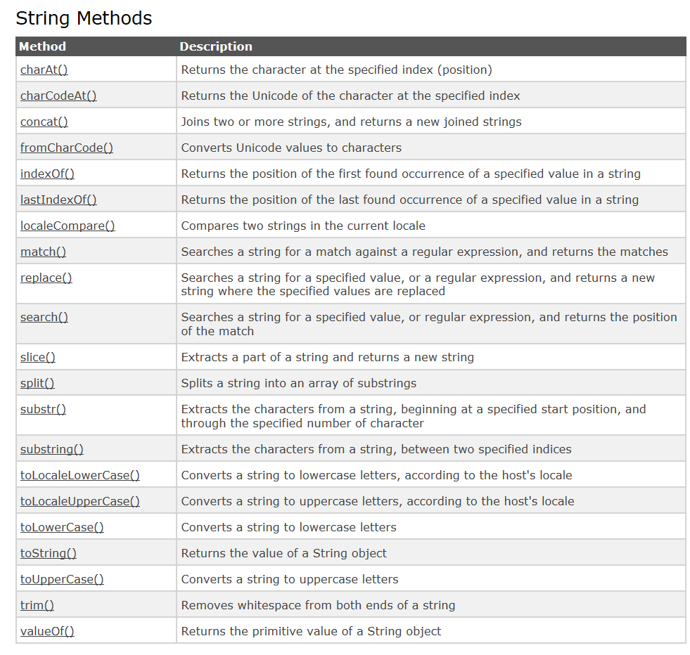
String functions

